Slide 1
The Time Value of Money

Slide 2
The Interest Rate
Which would you prefer -- $10,000 today or $10,000 in 5 years?
Obviously, $10,000 today.
You already recognize that there is TIME VALUE TO MONEY!!

Slide 3
Why TIME?
Why is TIME such an important element in your decision?
TIME allows you the opportunity to postpone consumption and earn INTEREST.

Slide 4

Time Value of Money
Money received today is worth more than the money received in the future.
The sooner your money can earn interest, the faster the interest can earn more interest.

Slide 5
The Terminology of Time Value
Present Value - An amount of money today, or the current value of a future cash flow
Future Value - An amount of money at some future time period
Period - A length of time (often a year, but can be a month, week, day, hour, etc.)
Interest Rate - The compensation paid to a lender for the use of funds expressed as a % for a period (normally expressed as an annual rate)

Slide 6
Timelines to Cash flows /Pay back periods
A timeline identifies the timing and amount of a stream of cash flows along with the interest rate.
A timeline is typically expressed in years, but it could also be expressed as months, days or any other unit of time.

Slide 7
Abbreviations
PV - Present value
FV - Future value
N - Either the total number of cash flows or the number of a specific period
i - The interest rate per period

Slide 8
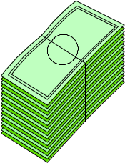
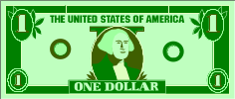
Timelines / Pay back period
  A timeline is a graphical device used to clarify the timing of the cash flows for an investment
  Each tick represents one time period
PV
FV
0
1
2
3
4
5
Today

Slide 9
Calculating the Future Value
Suppose that you have an extra $100 today that you wish to invest for one year. If you can earn 10% per year on your investment, how much will you have in one year?
-100
?
0
1
2
3
4
5

Slide 10

Calculating the Future Value (cont.)
Suppose that at the end of year 1 you decide to extend the investment for a second year. How much will you have accumulated at the end of year 2?
-110
?
0
1
2
3
4
5

Slide 11
Generalizing the Future Value
Recognizing the pattern that is developing, we can generalize the future value calculations as follows:
If you extended the investment for a third year, you would have:

Slide 12
Compound Interest
In other words, the amount of interest earned each year is increasing
  Year 1: $10
  Year 2: $11
  Year 3: $12.10
The reason for the increase is that each year you are earning interest on the interest that was earned in previous years in addition to the interest on the original principle amount

Slide 13
Cost-benefit analysis
Cost-benefit analysis is a set of practical procedures for guiding public expenditure decisions.

Slide 14
Present Value
Project evaluation usually requires comparing costs and benefits from different time periods
Dollars across time periods are not immediately comparable, because of inflation and returns in the market.

Slide 15
Future Dollars into the Present
Suppose someone promises to pay you $100 one year from now.
What is the maximum amount you should be willing to pay today for such a promise?
You are forgoing the interest that you could earn on the money that is being loaned.

Slide 16
Future Dollars into the Present
The present value of a future amount of money is the maximum amount you would be willing to pay today for the right to receive the money in the future.

Slide 17
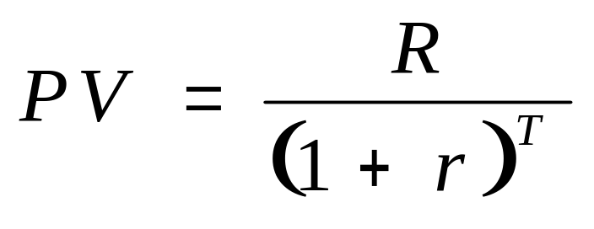
Present Dollars into the Future
Define
  R=amount to be received in future
  r=rate of return on investment
  T=years of investment
The present value (PV) of the investment is:
FIN3000, Liuren Wu

Slide 18
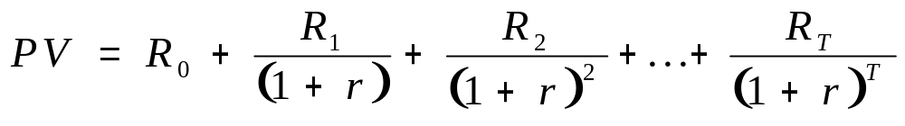
Future Dollars into the Present
In previous equation, r is often referred to as the discount rate, and (1+r)^{-T} is the discount factor.
Finally consider a promise to pay a stream of money, $R₀ today, $R₁ one year from now, and so on, for T years?
FIN3000, Liuren Wu

Slide 19
Future Dollars into the Present
Present value is an enormously important concept
A $1,000,000 payment 20 years from now is only worth today:
  $376,889 if r=.05
  $148,644 if r=.10

Slide 20
Present Value: Inflation
Nominal amounts are valued according to the level of prices in the year the return occurs.
Real amounts are valued according to the level of prices in one particular year.
Inflation affects both the payout stream, and the discount factor, and these two cancel each other out.

Slide 21
Annuity/pension
Definition :A financial product sold by financial institutions that is designed to accept and grow funds from an individual and then, upon annuitization, pay out a stream of payments to the individual at a later point in time. Annuities are primarily used as a means of securing a steady cash flow for an individual during their retirement years.
FIN3000, Liuren Wu

Slide 22
Annuities-(ordinary and due)
An annuity is a series of equal dollar payments that are made at the end of equidistant points in time such as monthly, quarterly, or annually over a finite period of time . If payments are made at the end of each period, the annuity is referred to as ordinary annuity.
Annuity due is an annuity in which all the cash flows occur at the beginning of the period. For example, rent payments on apartments are typically annuity due as rent is paid at the beginning of the month.

Slide 23
Amortized Loans
An amortized loan is a loan paid off in equal payments – consequently, the loan payments are an annuity.
Examples: Home mortgage loans, Auto loans
In an amortized loan, the present value can be thought of as the amount borrowed, n is the number of periods the loan lasts for, i is the interest rate per period, and payment is the loan payment that is made.
FIN3000, Liuren Wu

Slide 24
Perpetuities
A perpetuity is an annuity that continues forever or has no maturity. For example, a dividend stream on a share of preferred stock. There are two basic types of perpetuities:
  Growing perpetuity in which cash flows grow at a constant rate, g, from period to period.
  Level perpetuity in which the payments are constant rate from period to period.
Even if the cash flows are infinite, present values can be finite if the discount rate is higher than the growth rate.

Slide 25

FIN3000, Liuren Wu

Slide 26
Inflation
  Is a steady and upward movement in the level of prices decreasing purchasing power over a period of time, usually one year.
  The Consumer Price Index (CPI) is the official measure of inflation .

Slide 27
Measuring Inflation
The CPI can be thought of as an imaginary ‘basket’ of selected goods and services bought by a typical capital city household.
The CPI is merely a measure of the changes in the price of this basket of goods and services.
The price of the CPI basket in the base (first) period is given a value of 100 and the prices of subsequent periods are compared against the base year.

Slide 28
Measuring Inflation
The basket of goods and services upon which the CPI is based is divided into 8 groups. Which are further divided into a number of sub-groups and then into specific expenditure classes.

Slide 29
Measuring Inflation
The eight groups of the CPI are as follows
  Food
  Clothing
  Housing
  Education and Recreation
  Transportation
  Tobacco and drinks
  Health and Personal Care
  Household Equipment and Operation

Slide 30
Measuring Inflation
To reflect the importance of each expenditure class in relation to total household expenditure, weight or measure of relative importance to each expenditure class in the CPI, are attached to each item in the index.

Slide 31
Measuring Inflation
The usefulness of an index number in statistics is to allow comparisons of data between one period and another, using a common unit of measurement.

Slide 32
Constructing the CPI Index
 |  | Period | 1 | Period | 2
Commodity | Weight | Price | WXP | Price | WXP
Food | 40 | 0.65 | 26 | 0.80 | 32
Clothing | 30 | 0.70 | 21 | 0.80 | 24
Housing | 20 | 1.15 | 23 | 1.15 | 23
Recreation | 10 | 1.00 | 10 | 1.10 | 11
Total | 100 |  | 80 |  | 90
Price Index |  | 100 |  |  | 112.50
Notes:
Economics - Notes for Teachers
Inflation and Types of Inflation
Academic PowerPoint

Slide 33
Calculating Inflation
Year 2 cost x 100
= Therefore
Year 1 cost 1
90 x 100
= 112.5
80 1

Slide 34
Calculating Inflation
112.5 – 100 (Base Year) = 12.5 %
From this we can say over the year, average prices increased by 12.5 %.

